Slide 1
Obesity Level Prediction
ASDS 6303
Lijuan Tang /Hariharan Selvam

Slide 2
Table of contents
01
02
03
04
05
Objective
Dataset
EDA
Model Comparison
Comment

Slide 3
01 Problem Statement
“Obesity, which causes physical and mental problems, is a global health problem with serious consequences. ”

Slide 4
02 Dataset
2111 Observations
0 missing values
Removed 24 duplicated rows
17 Variables including 1 target labels
3 Numerical features: Age, Height, Weight
13 Categorical features: Gender, FCVC( How often eat vegetables),etc.

Slide 5
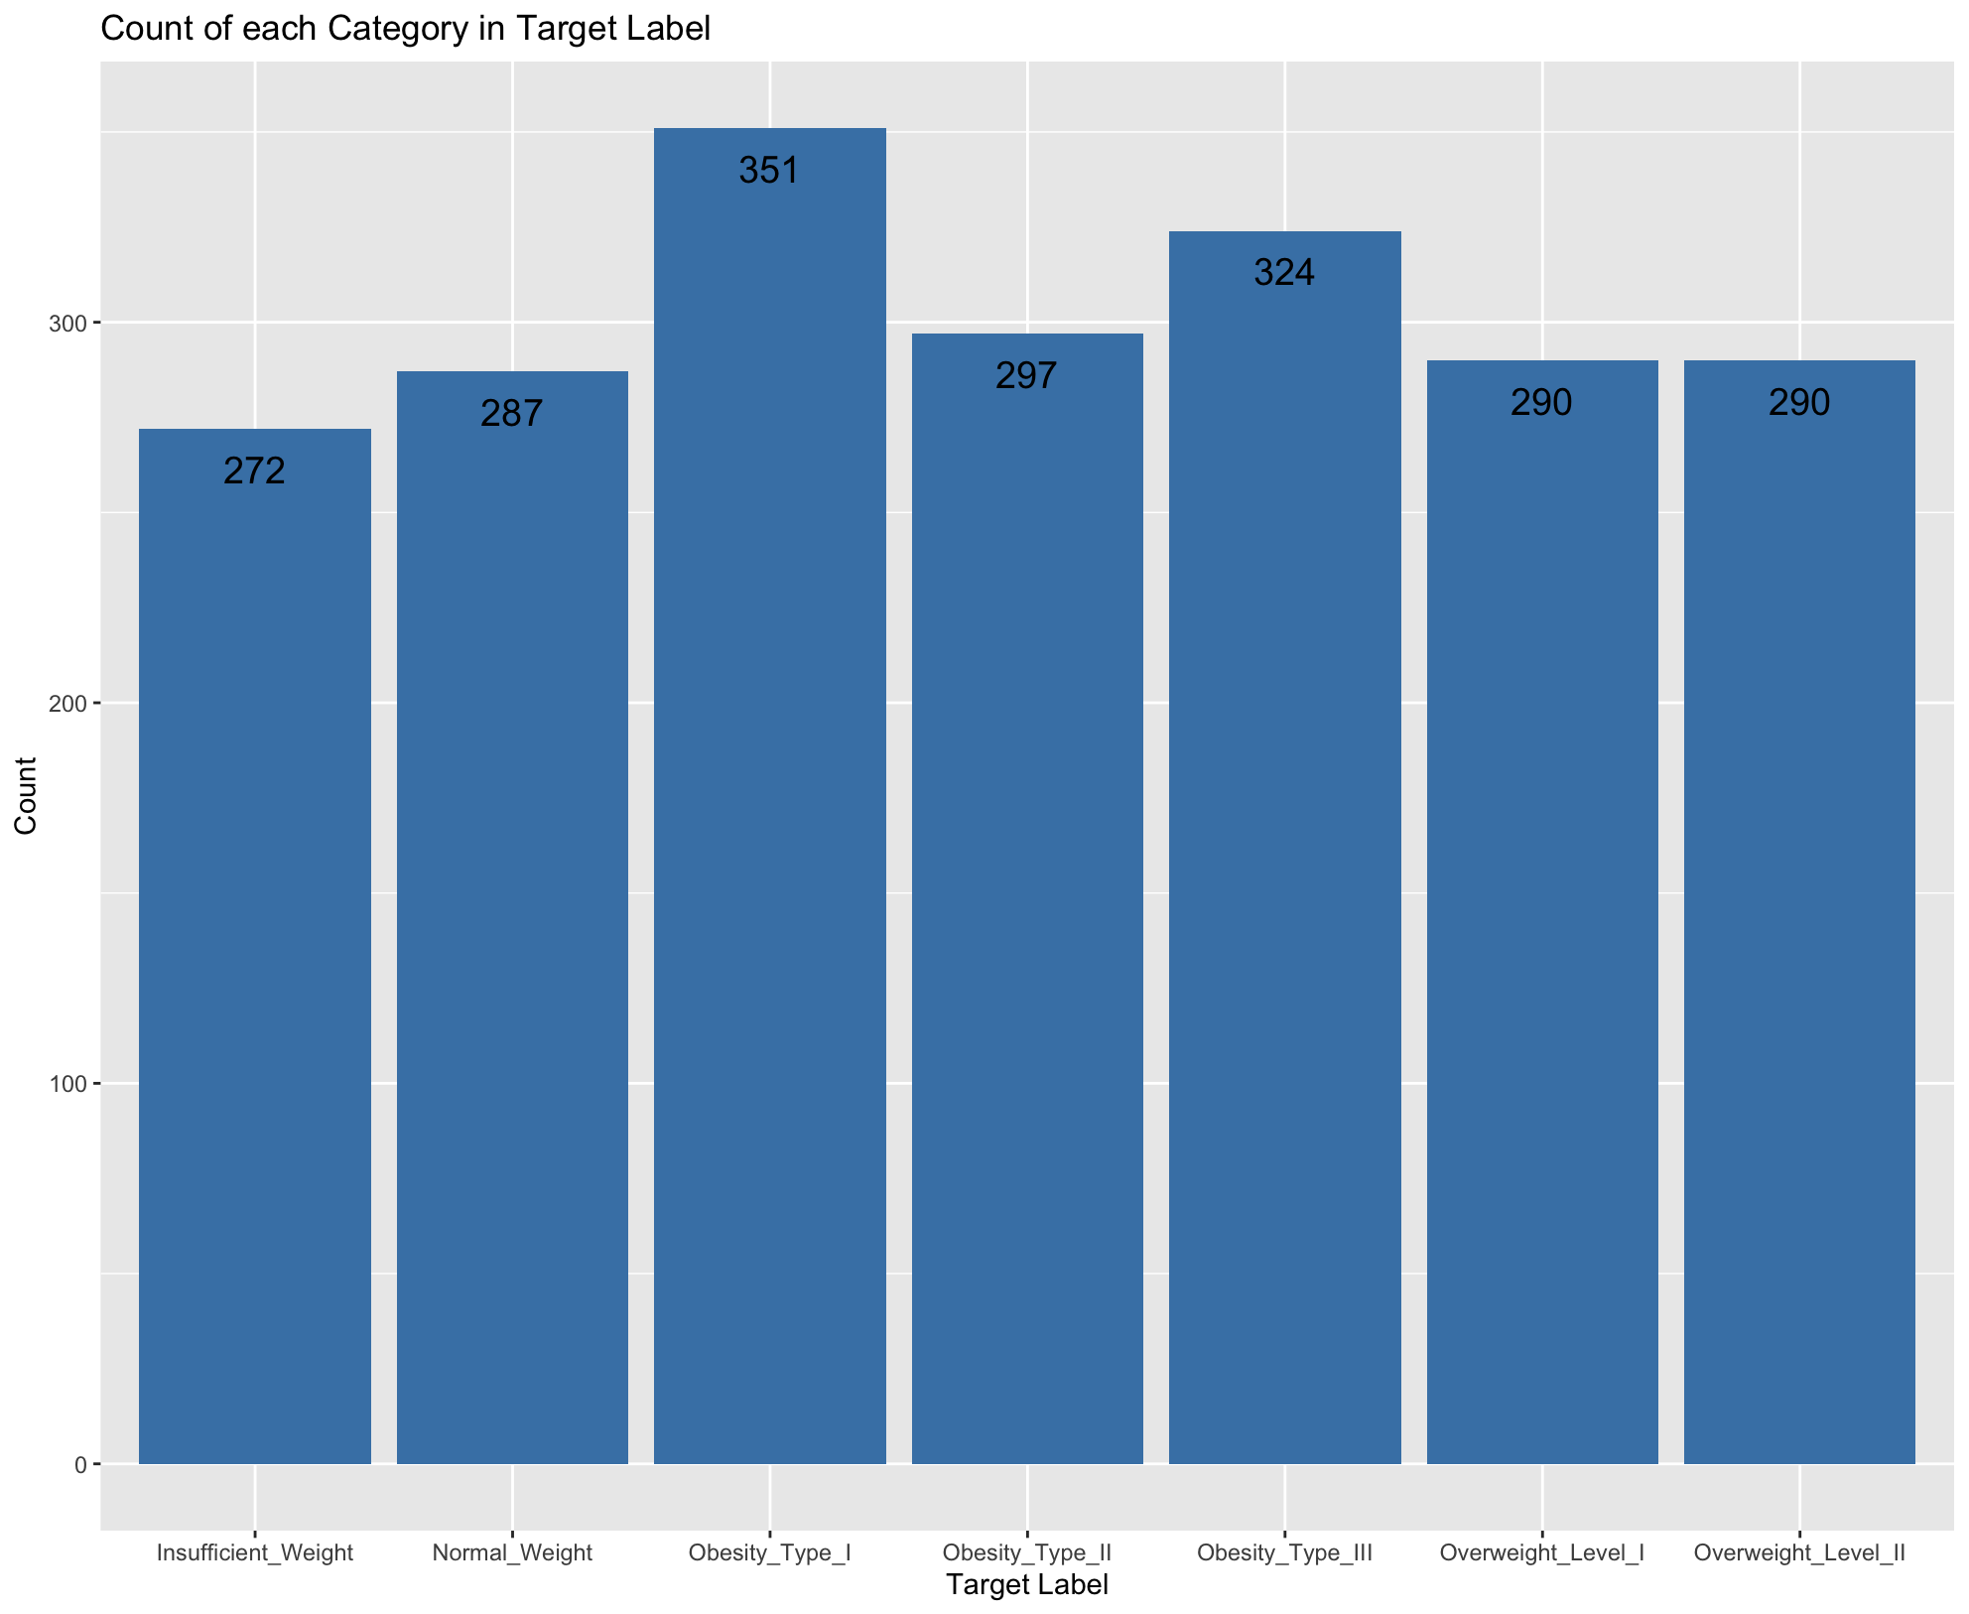
03 EDA
7 levels
Balanced Dataset

Slide 6
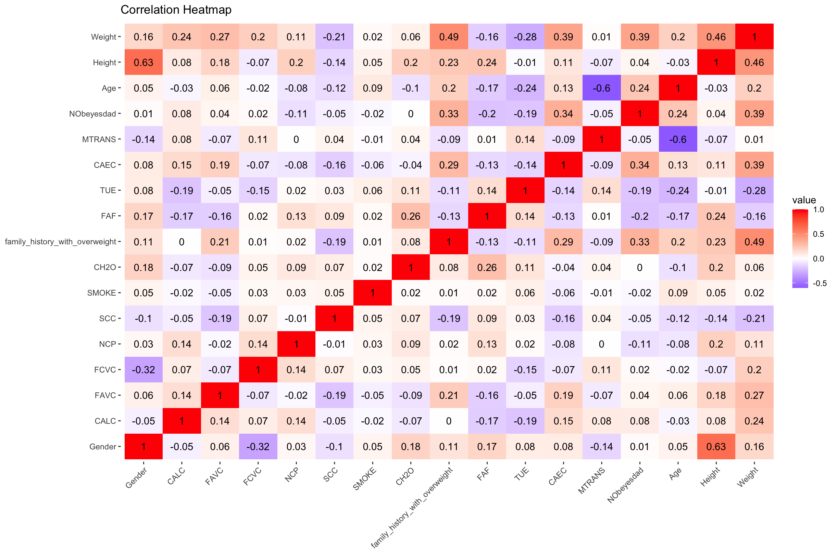
Correlation Matrix
It shows obesity level has a slightly positive relationship with weight, age and family history with overweight.
No highly correlated features.

Slide 7
04
Model Comparison

Slide 8
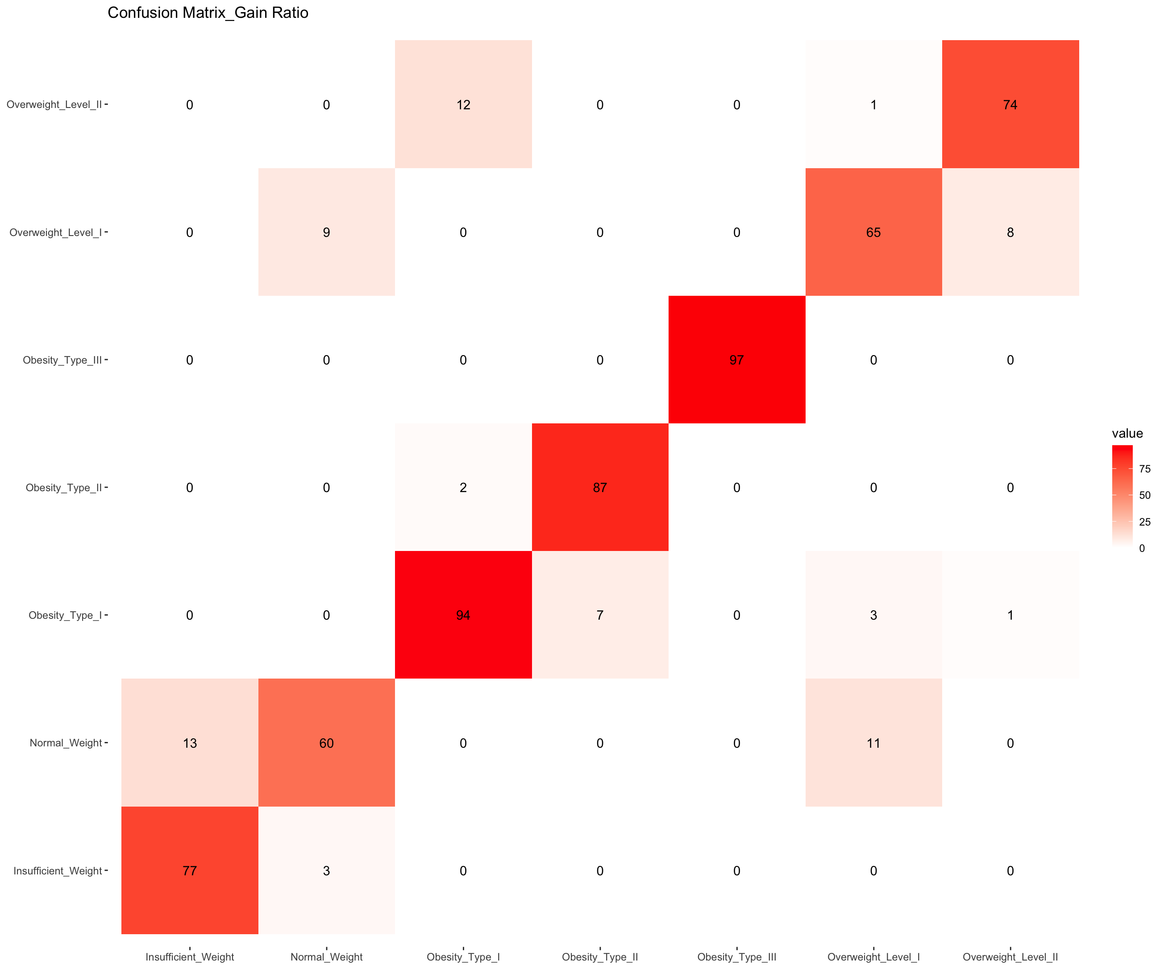
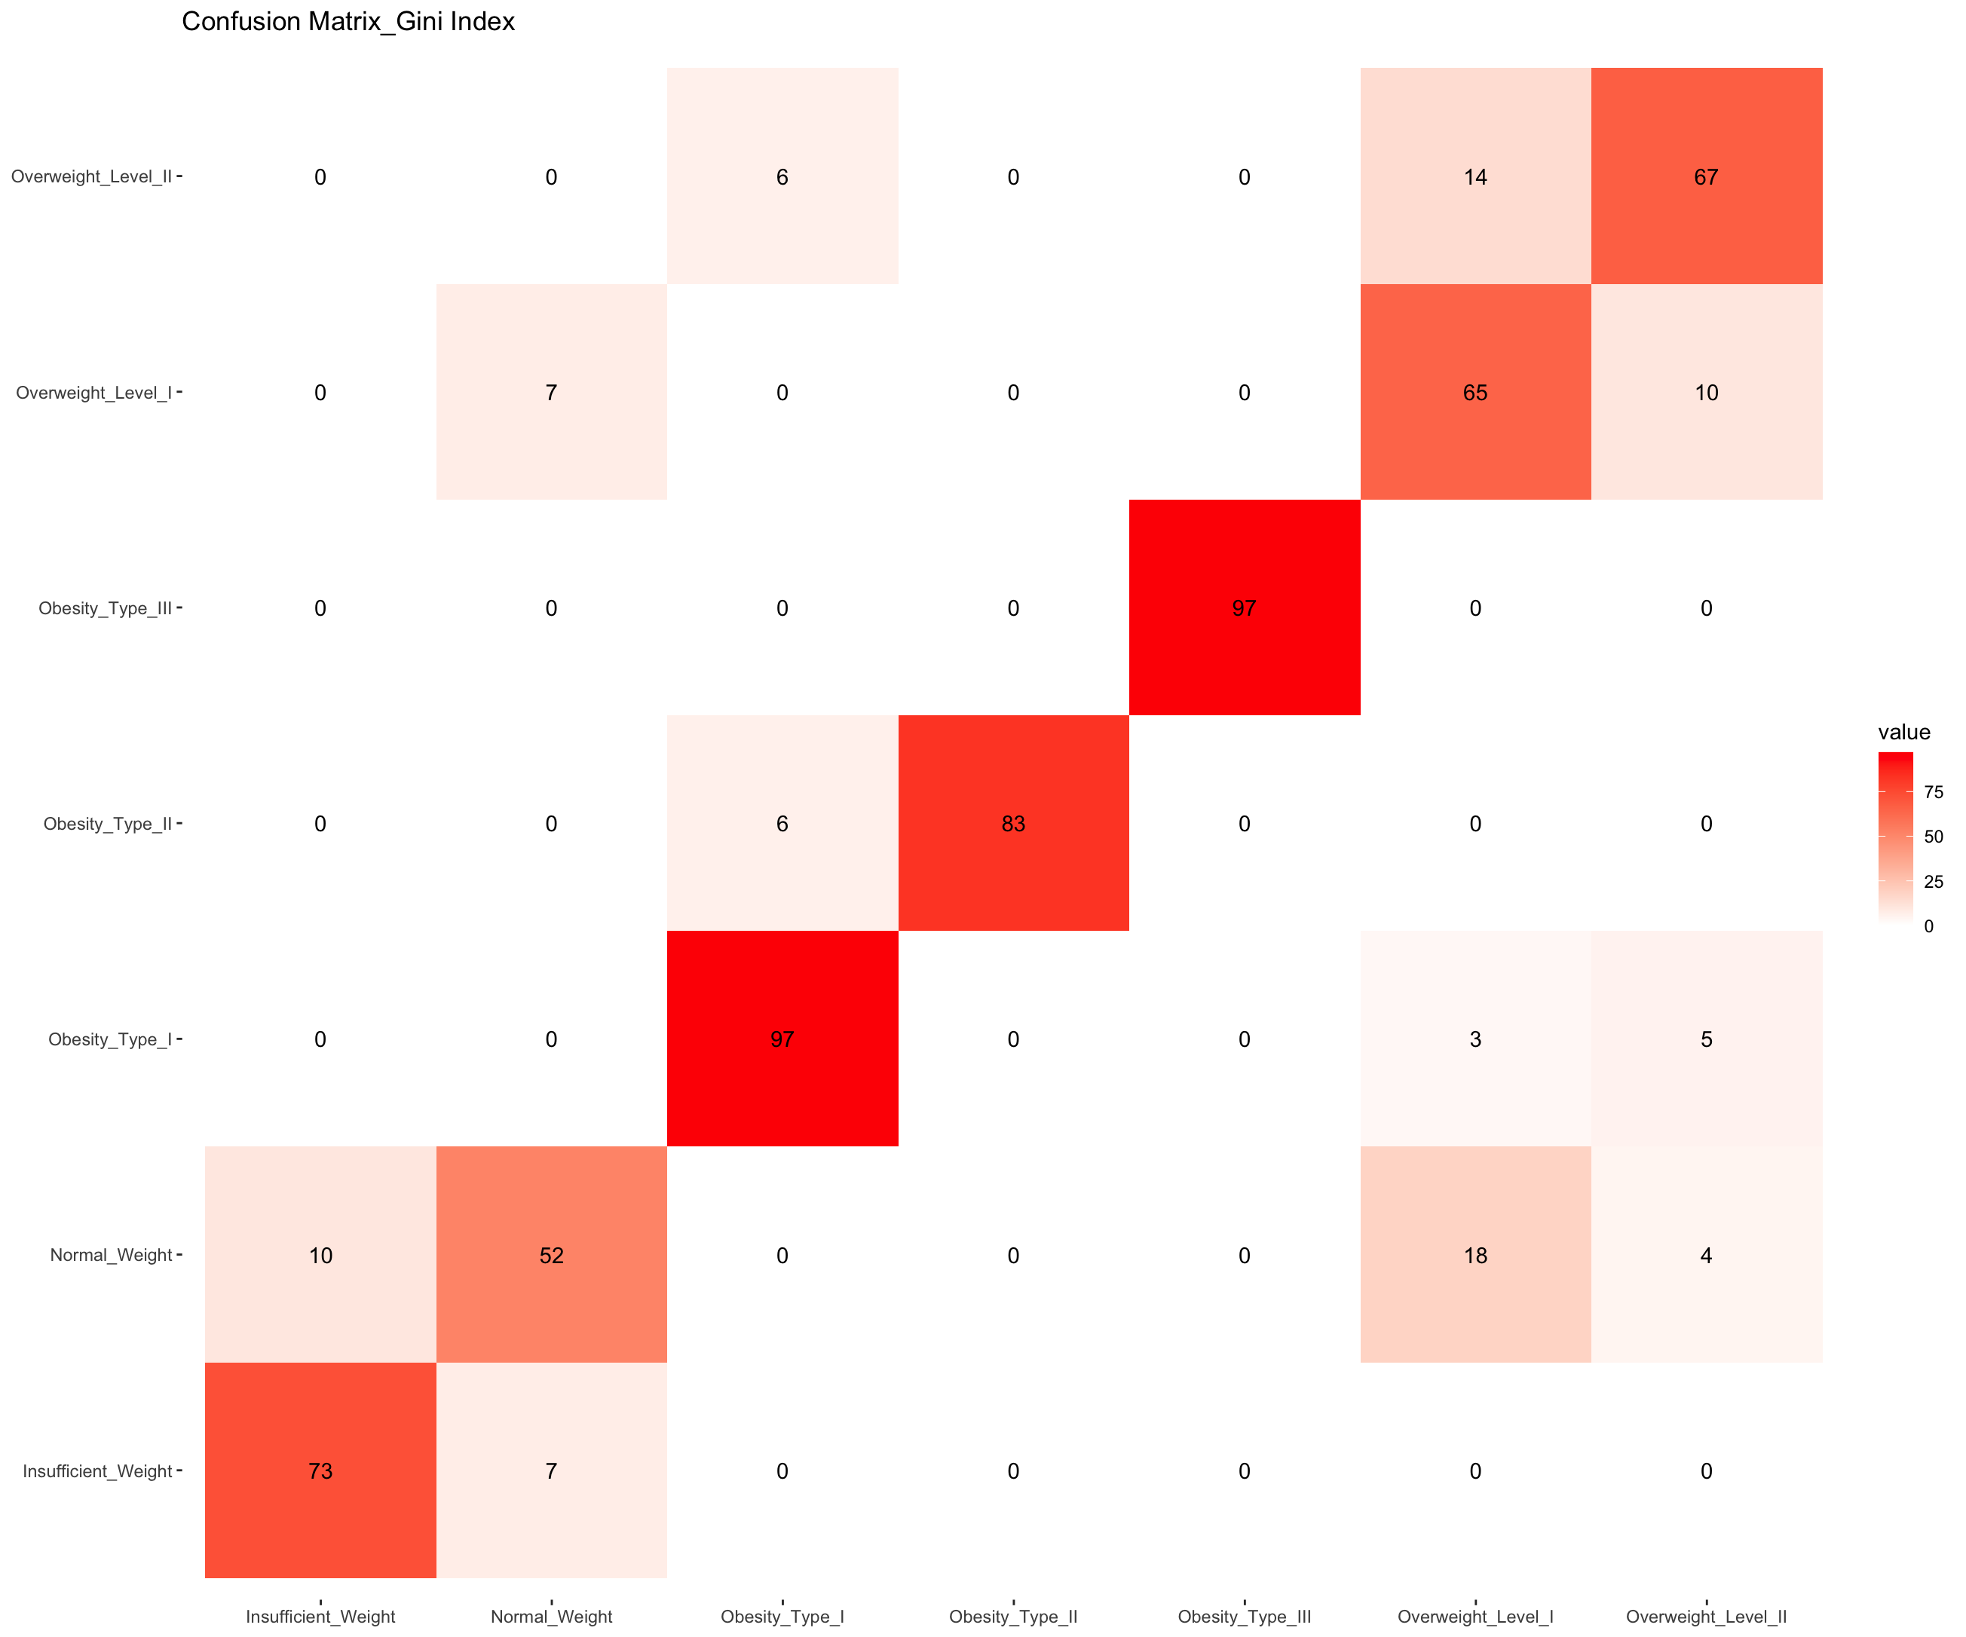
Actual
Predicted
Predicted
Accuracy: 0.8878
Accuracy: 0.8558

Slide 9
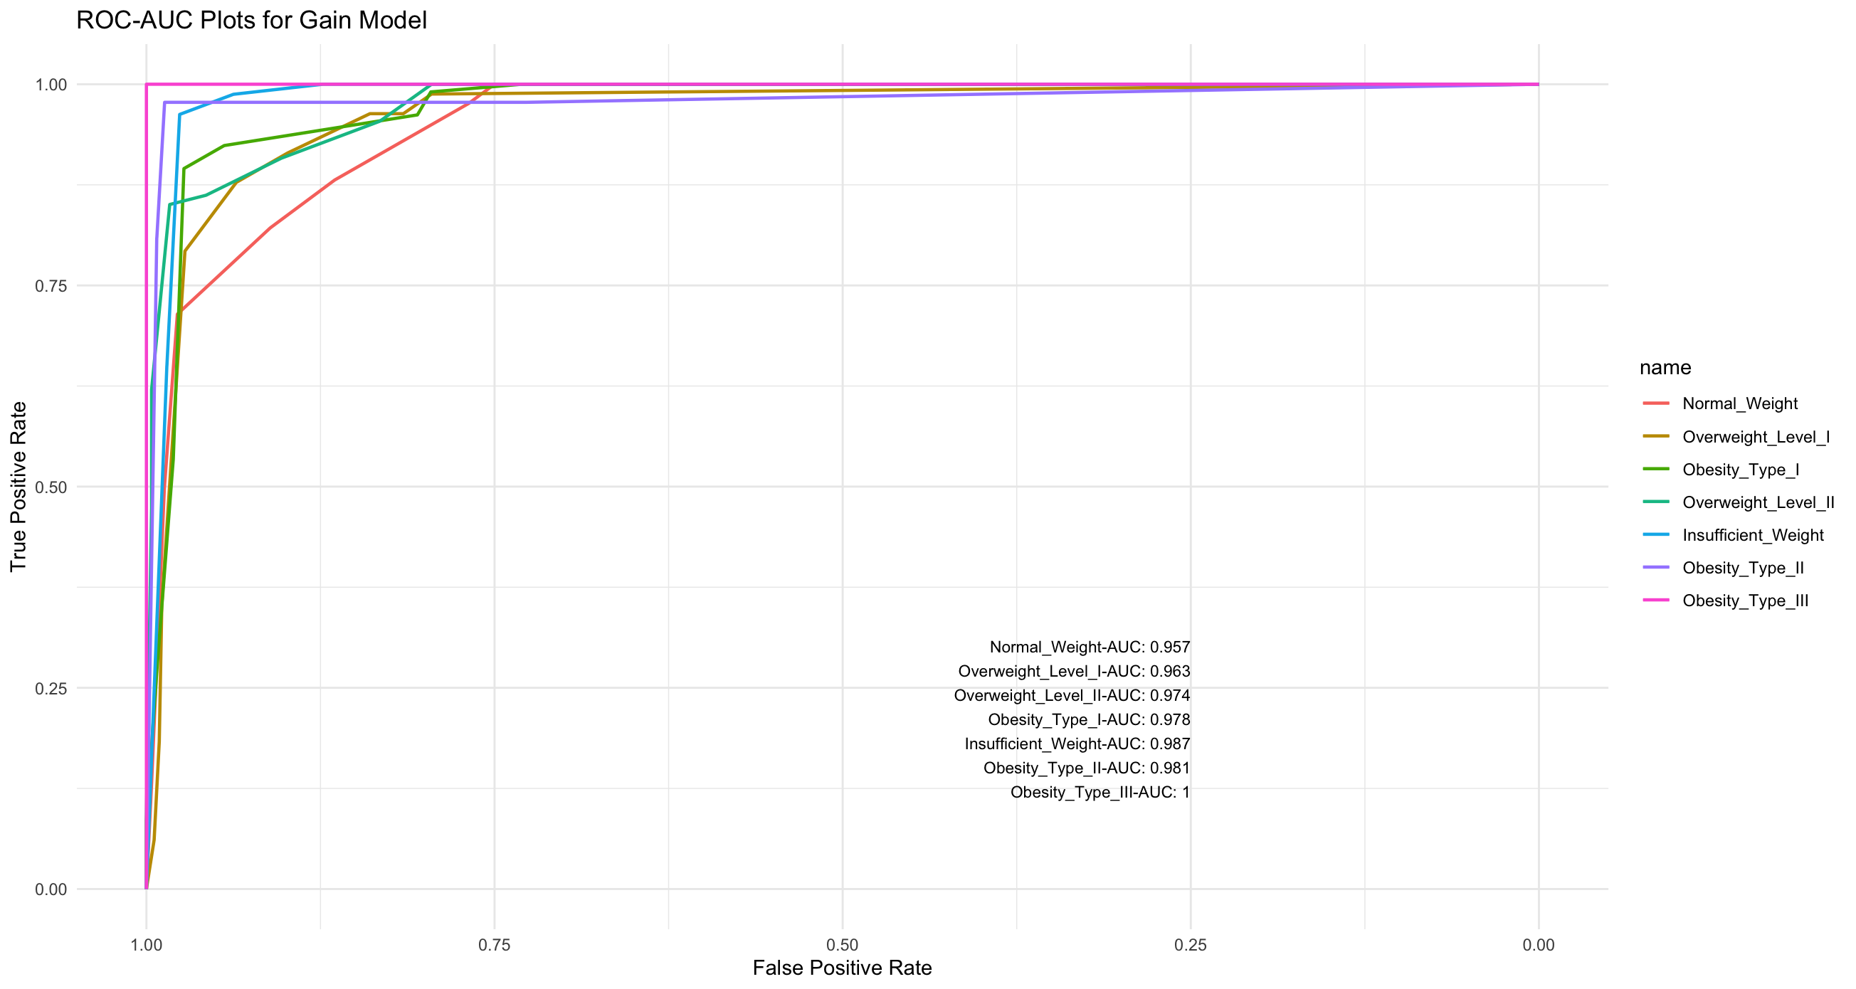
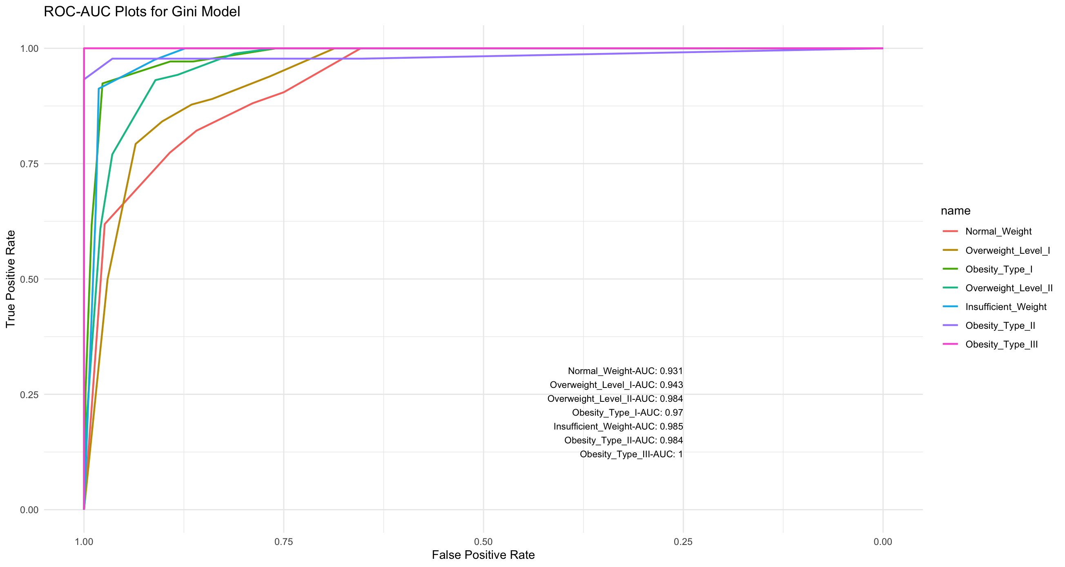
ROC-AUC
Each ROC curve represents the performance of the classifier for that specific class compared to all other classes.

Slide 10
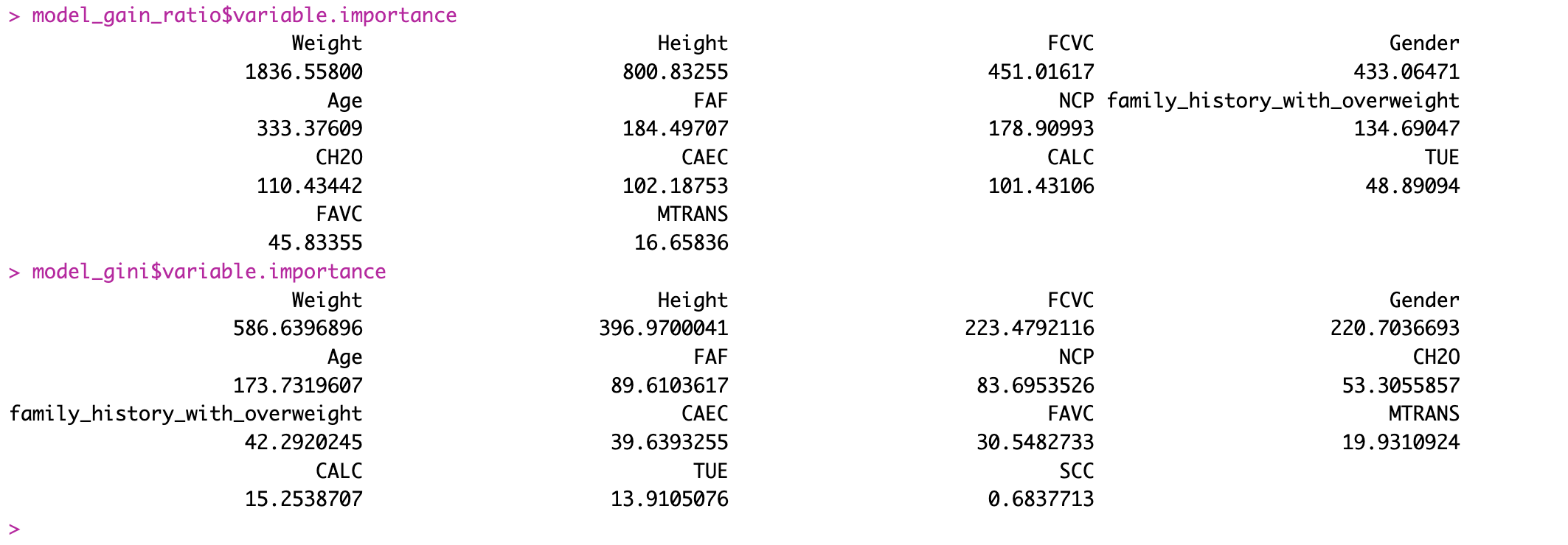
Difference
191 nodes (Gain) vs 95 nodes (Gini)
Variable Importance

Slide 11
Conclusion
Most of the time it does not make a big difference: they lead to similar trees.
They both aim to minimize impurity or maximize information gain

Slide 12
Thanks
Please keep this slide for attribution

